Slide 1
Student Well-Being and Depression:
A Data-Driven Perspective
Helen & Reagan
Bachelor of Science - Data Science
MATH 2444 - Statistical Data Analysis

Slide 2
Data Understanding
Data Source: Kaggle
Goal/ Research Hypothesis: Identify the predictors that are significantly associated with the odds of depression in student population
Dependent Variable:
Depression
Independent Variable(s): (9) Gender, Age, Academic Pressure, Financial stress, Family History of Mental Illness, Dietary Habits, Study Satisfaction, Study hour and Sleep Duration

Slide 3
Statistical Procedures Used
Multiple Logistic Regression
Ho: There is no/statistically significant relationship between predictor variable(s) and the response variable (Depression)
Ha: There is a relationship/statistically significant relationship between the predictor variable(s) and the response variable (Depression)

Slide 4
Basic Descriptive Measures
N = 502 participants
Gender:
235 Females
267 Males
Age:
200 Age 18-24
152 Age 25-29
150 Age 30-34
Family History of Mental illness:
265 said no
237 said yes
Study Satisfaction:
86 Rated 1
100 Rated 2
103 Rated 3
116 Rated 4
97 Rated 5
Sleep Duration:
123 Less than 5 hours
123 5-6 hours
128 7-8 hours
128 More than 8 hours
Dietary Habits:
169 Unhealthy
172 Moderate
161 Healthy
Financial Stress:
110 Rated 1
102 Rated 2
100 Rated 3
94 Rated 4
96 Rated 5
Academic Pressure:
99 Rated 1
88 Rated 2
125 Rated 3
92 Rated 4
98 Rated 5
Depression:
252 said yes
250 said no

Slide 5
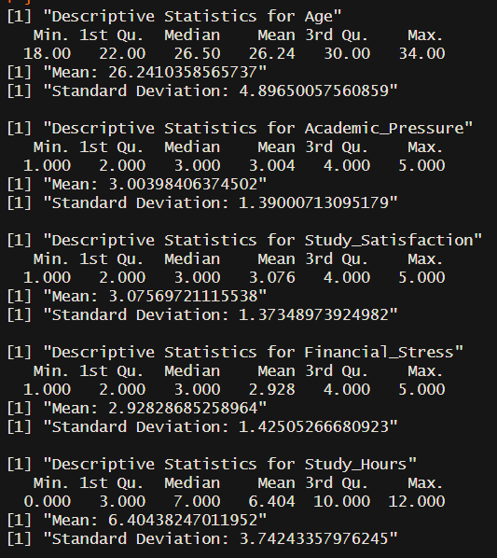
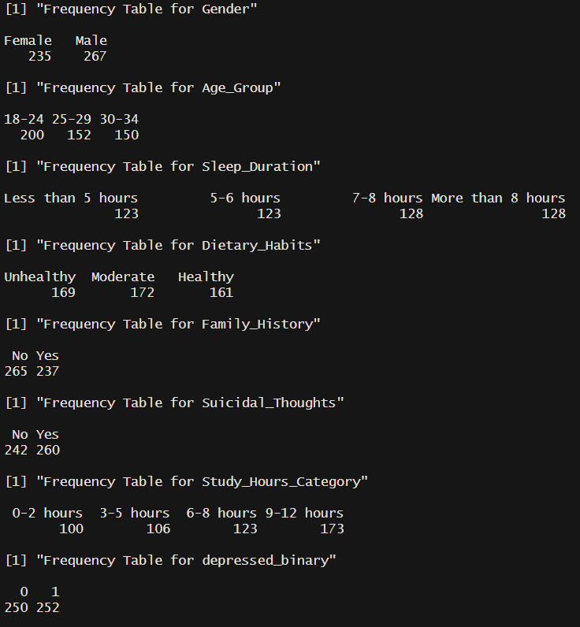

Slide 6
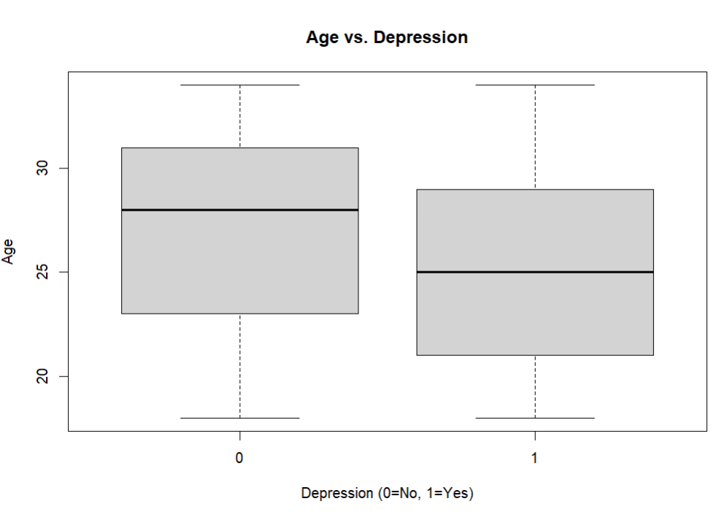
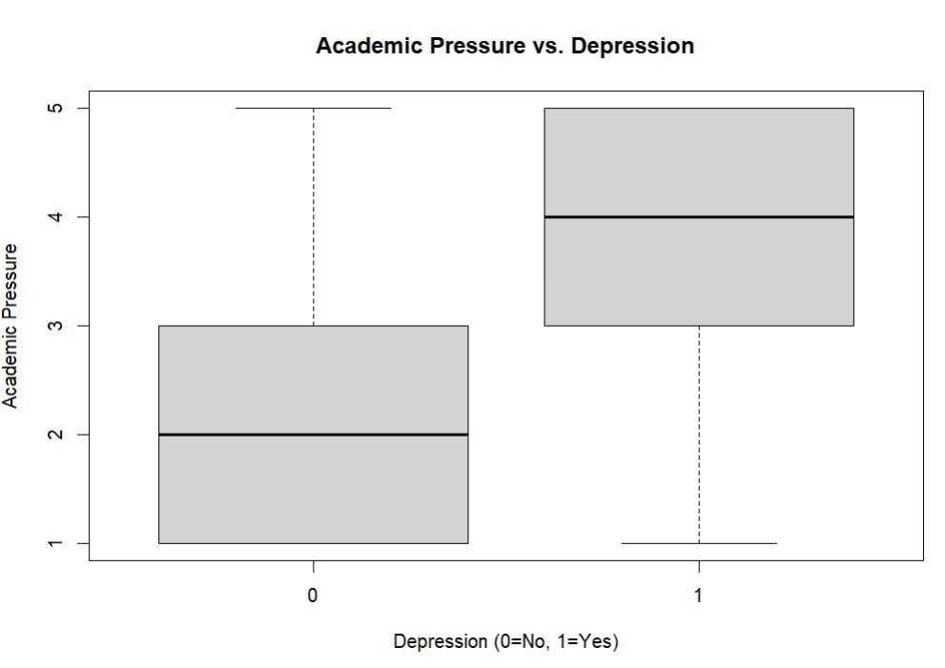
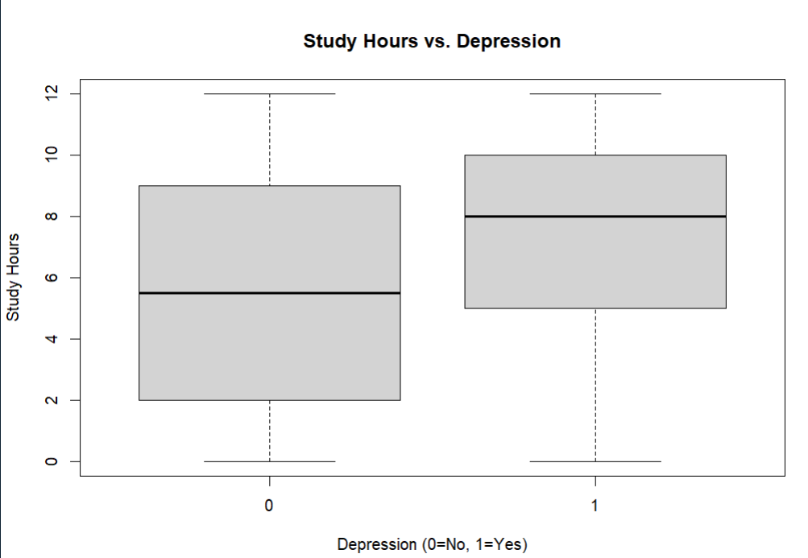
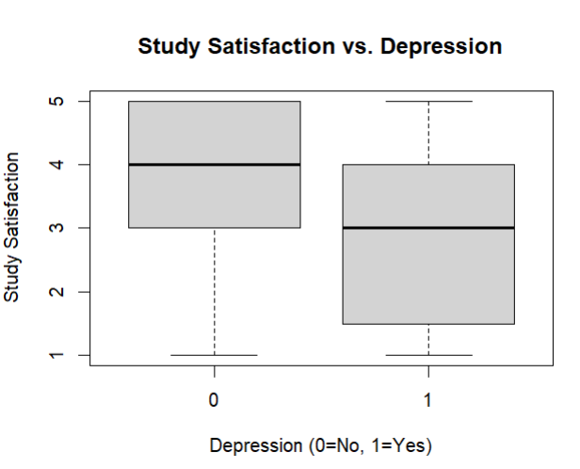
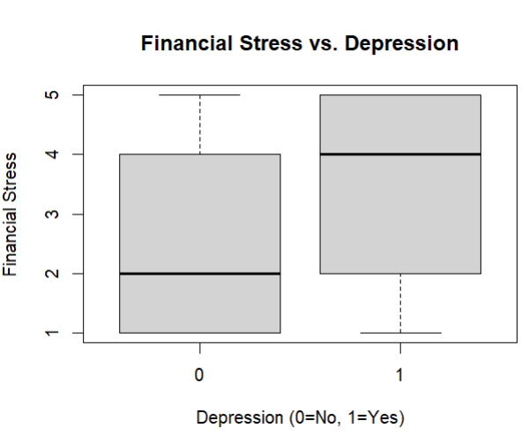
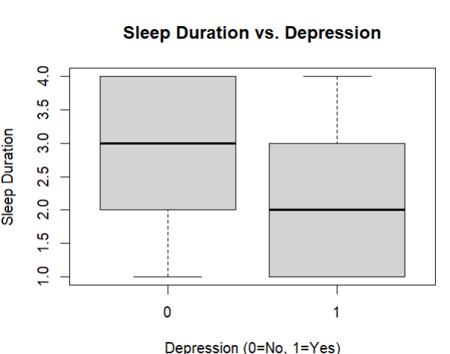
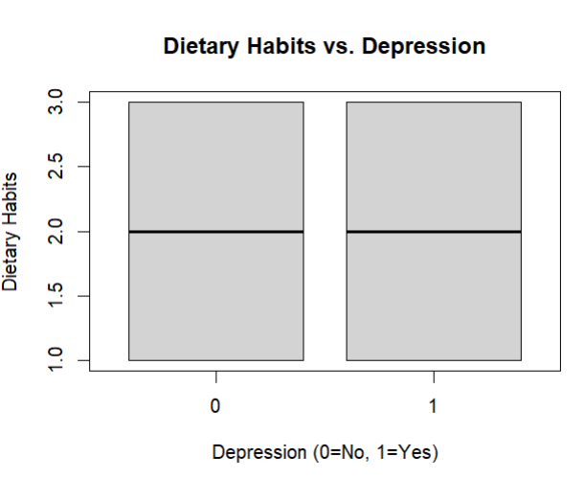
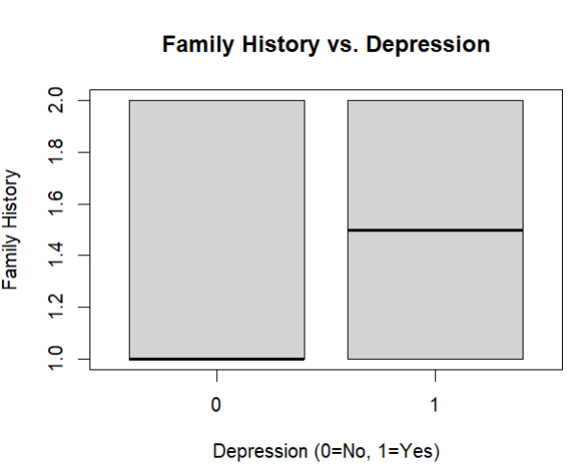
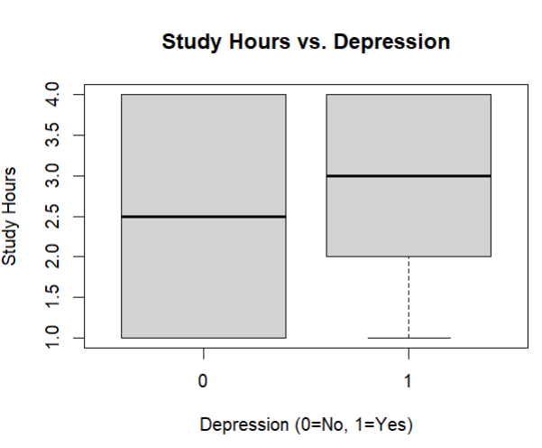

Slide 7
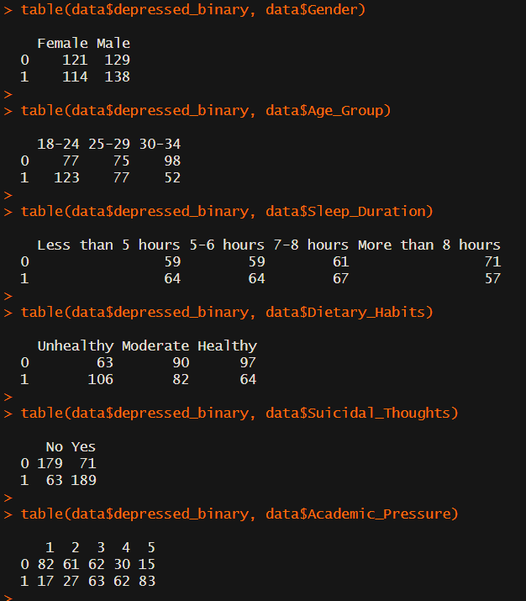
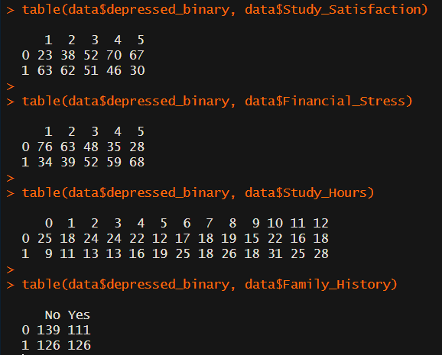
Basic Descriptive Measures

Slide 8
Statistical Procedures
Excel:
Data
Replaced “Yes” and “No” with “1” and “0” for Depression
R:
Removed Suicidal Thoughts as it has high association to Depression
Almost all participant with suicidal thoughts have depression
Quasi-Complete Separation
The predictor almost perfectly predicts the outcome
Leads to unstable results and unrealistic probabilities
Logistic regression model
Stepwise Selection
Odds Ratio
Notes:
Animation here

Slide 9
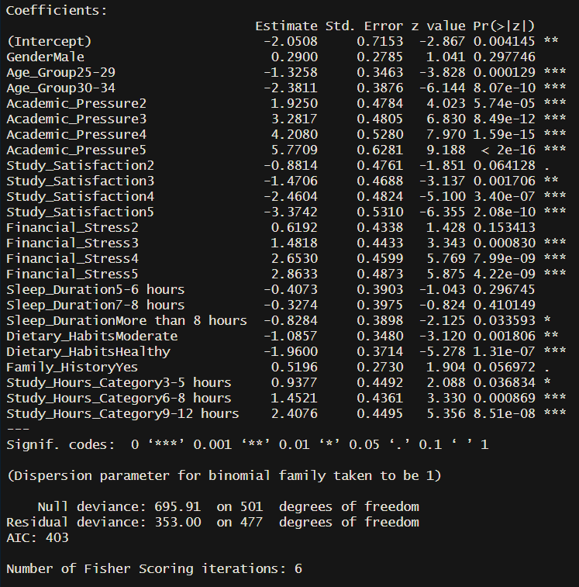
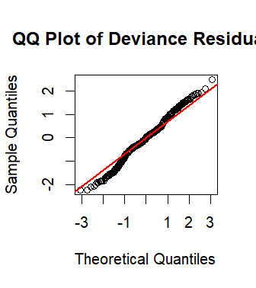
Key Outputs
QQ plot indicating the data is normally distributed

Slide 10
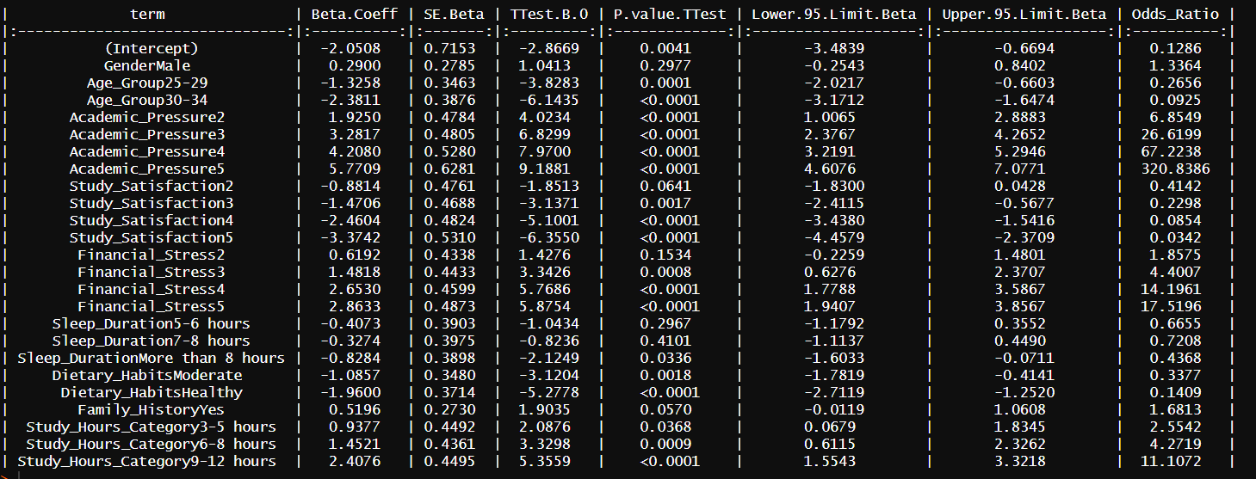
Key Outputs: Full Table

Slide 11
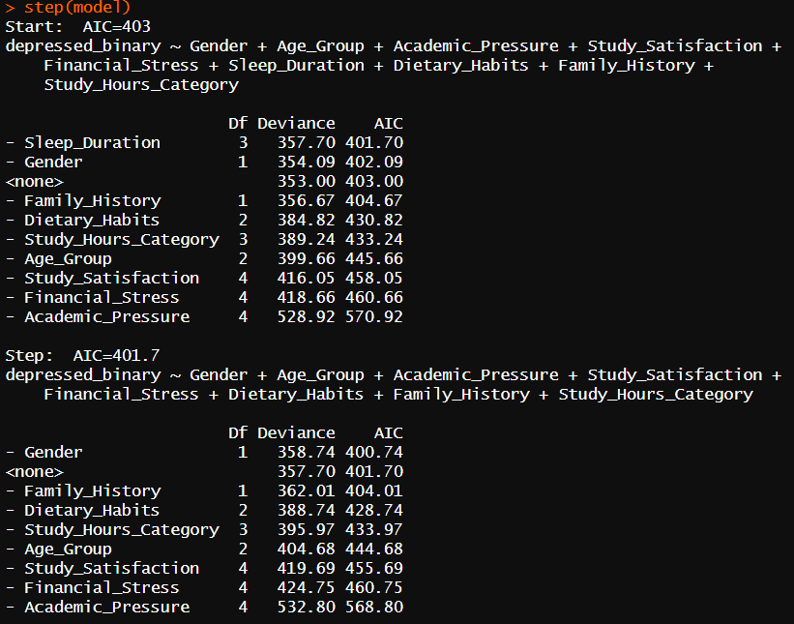
Key Outputs: Stepwise Selection

Slide 12
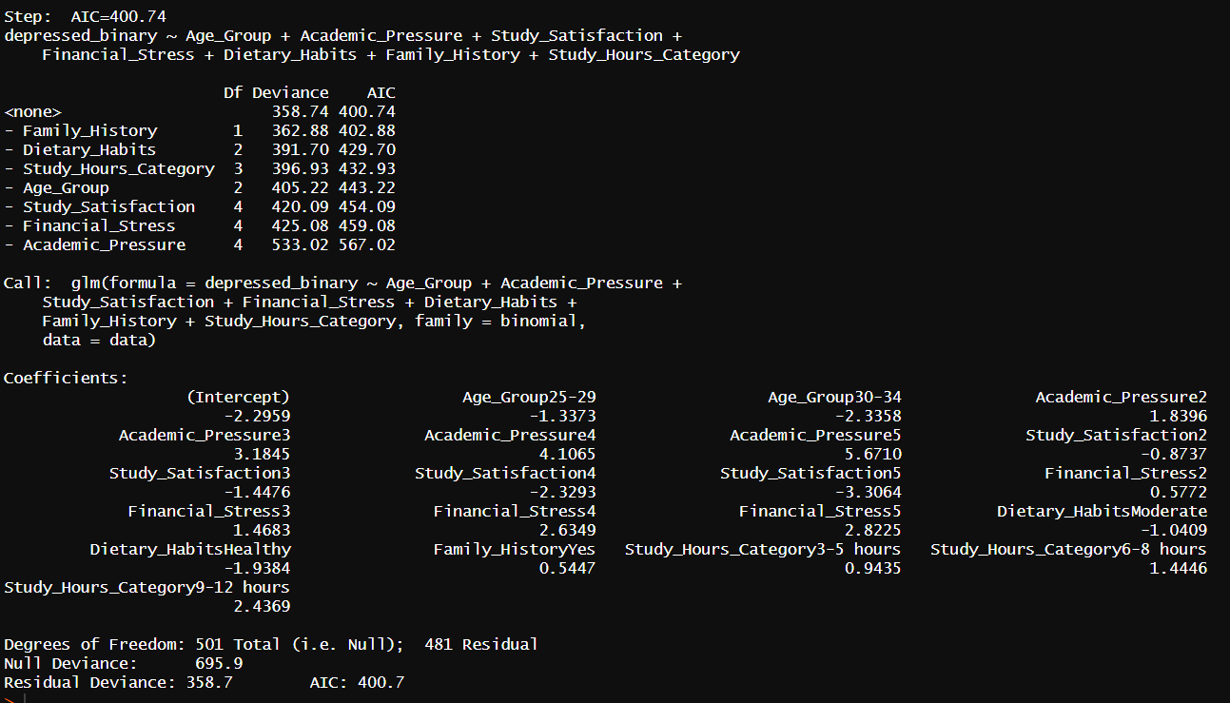
Key Outputs: Stepwise Selection

Slide 13
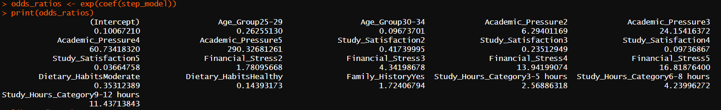
Key Outputs: Odds Ratio
MM.DD.YYYY
Odds ratio > 1: Higher Odds of depression in the group
Odds ratio < 1: Lower Odds of depression in the group
Odds ratio = 1: No effect on the Odds of depression
Notes:
P values:
step(glm(
Odds ratio for all the factors
vif

Slide 14
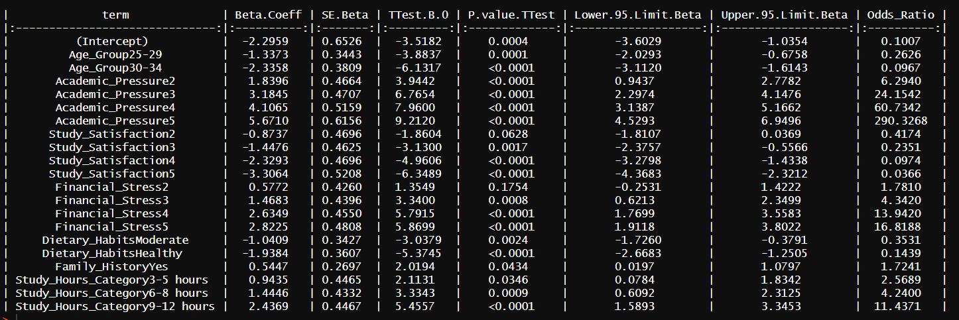
Key Outputs: Full Table
Notes:
Animation here

Slide 15
Conclusion
Based on the p-value of the intercept (0.0004), the overall logistic regression model is statistically significant. Age group, academic pressure, study satisfaction, financial stress, dietary habits, family history, and study hours category are all found to be significantly associated with the odds of depression.
Students with financial stress, academic pressure, family history, and amount of study hours all have a odds ratio greater than one, suggesting that students in those groups are associated with higher odds of depression. As the pressure/stress and study hours increase, the odds of depression also increases.
Age, study satisfaction, and dietary habits are associated with lower odds of depression.

Slide 16
Reference:
Kaggle. Depression Student Dataset. https://www.kaggle.com/datasets/ikynahidwin/depression-student-dataset
UCLA. (n.d.). FAQ What is complete or quasi-complete separation in logistic/probit regression and how do we deal with them? https://stats.oarc.ucla.edu/other/mult-pkg/faq/general/faqwhat-is-complete-or-quasi-complete-separation-in-logisticprobit-regression-and-how-do-we-deal-with-them/

